Slide 1

Bellabeat marketing analysis
Sivasankari anandan
12/12/2024

Slide 2
introduction
This analysis will focus mainly on the Bellabeat app, which has user health data related to their daily activity, sleep, stress, menstrual cycle, and mindfulness habits.
This data can help users better understand their current habits and make healthy decisions. The Bellabeat app connects to their line of smart wellness products.

Slide 3
Process (import libraries)
library(tidyverse) library(dplyr) (library(data.table) library(skimr) library(janitor) library(here) library(psych) library(chron) library(ggpubr) library(VennDiagram) library(ggpubr) library(corrplot) library(openair)

Slide 4
Load the dataset
To answer our business task, we will mainly use these data:
Daily Activity (including Steps, Distance, Intensities, Active Minutes, and Calories)
Daily & Hourly Calories
Daily Sleep
Daily Intensities
Daily & Hourly Steps

Slide 5
Clean & format the data
Before we start, we want to check the structure of each table and the summary for each column.

Slide 6
analyze
Steps
Sleep
Calories
Intensity
Steps,Calories and Sleep
Minutes Asleep and Serentary minu.
Active Minutes and METs
Calories and METs

Slide 7
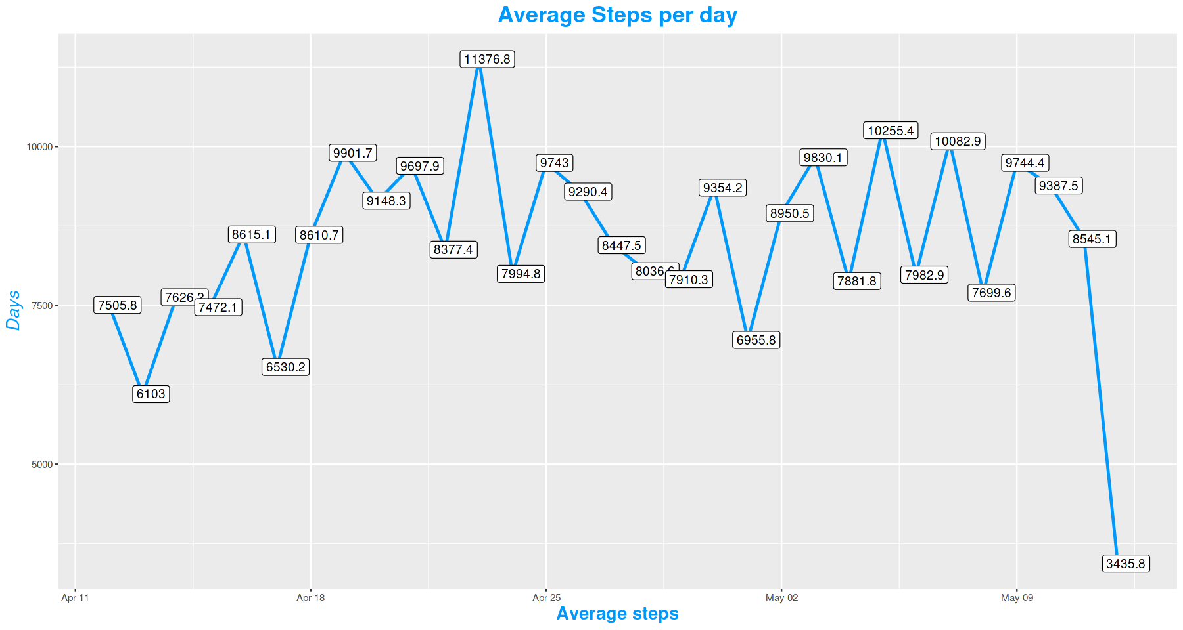
steps

Slide 8
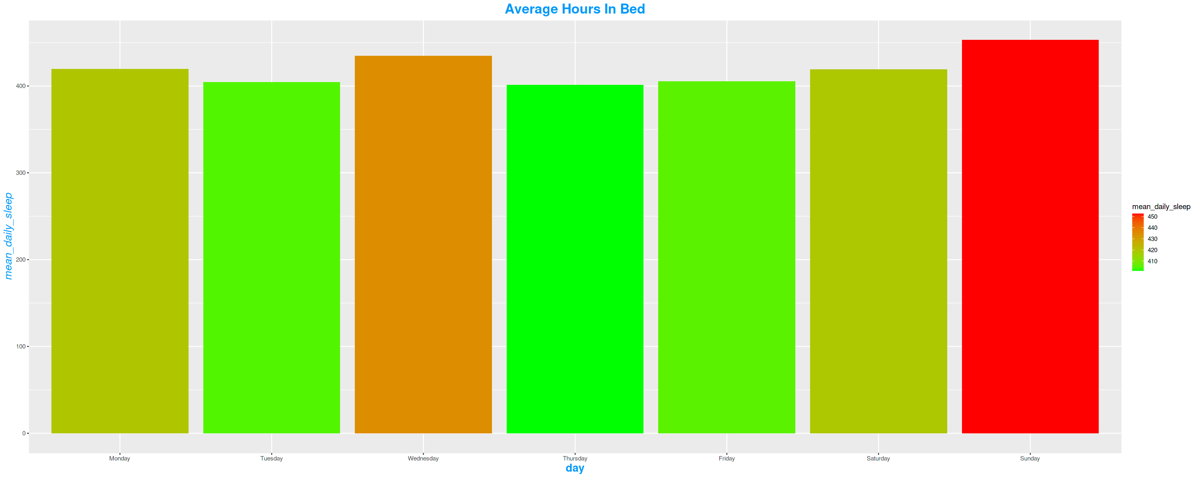
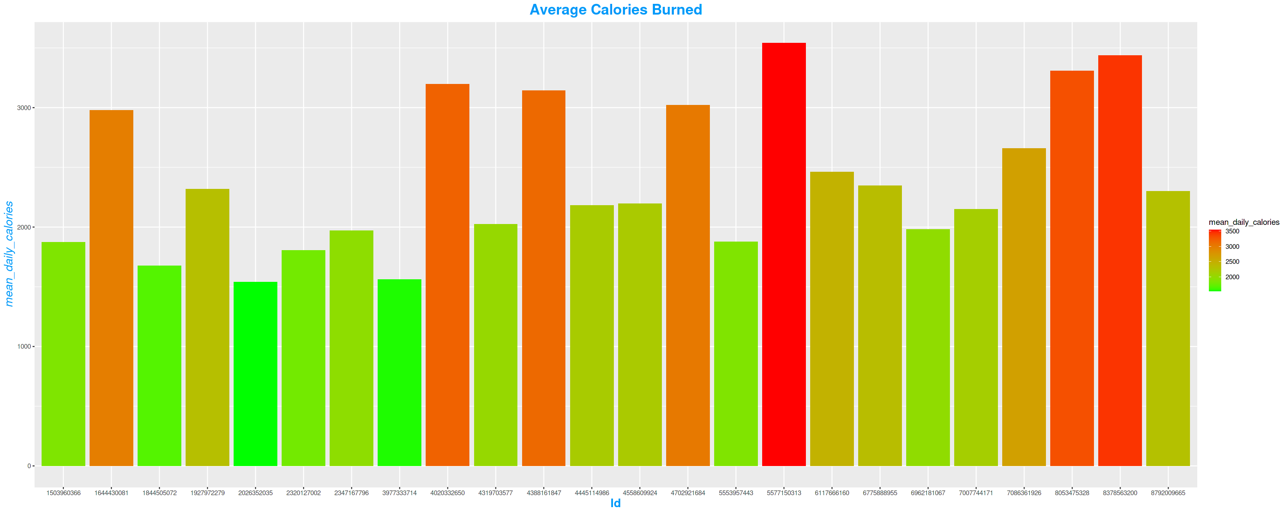
Analyze
Sleep
Calories

Slide 9
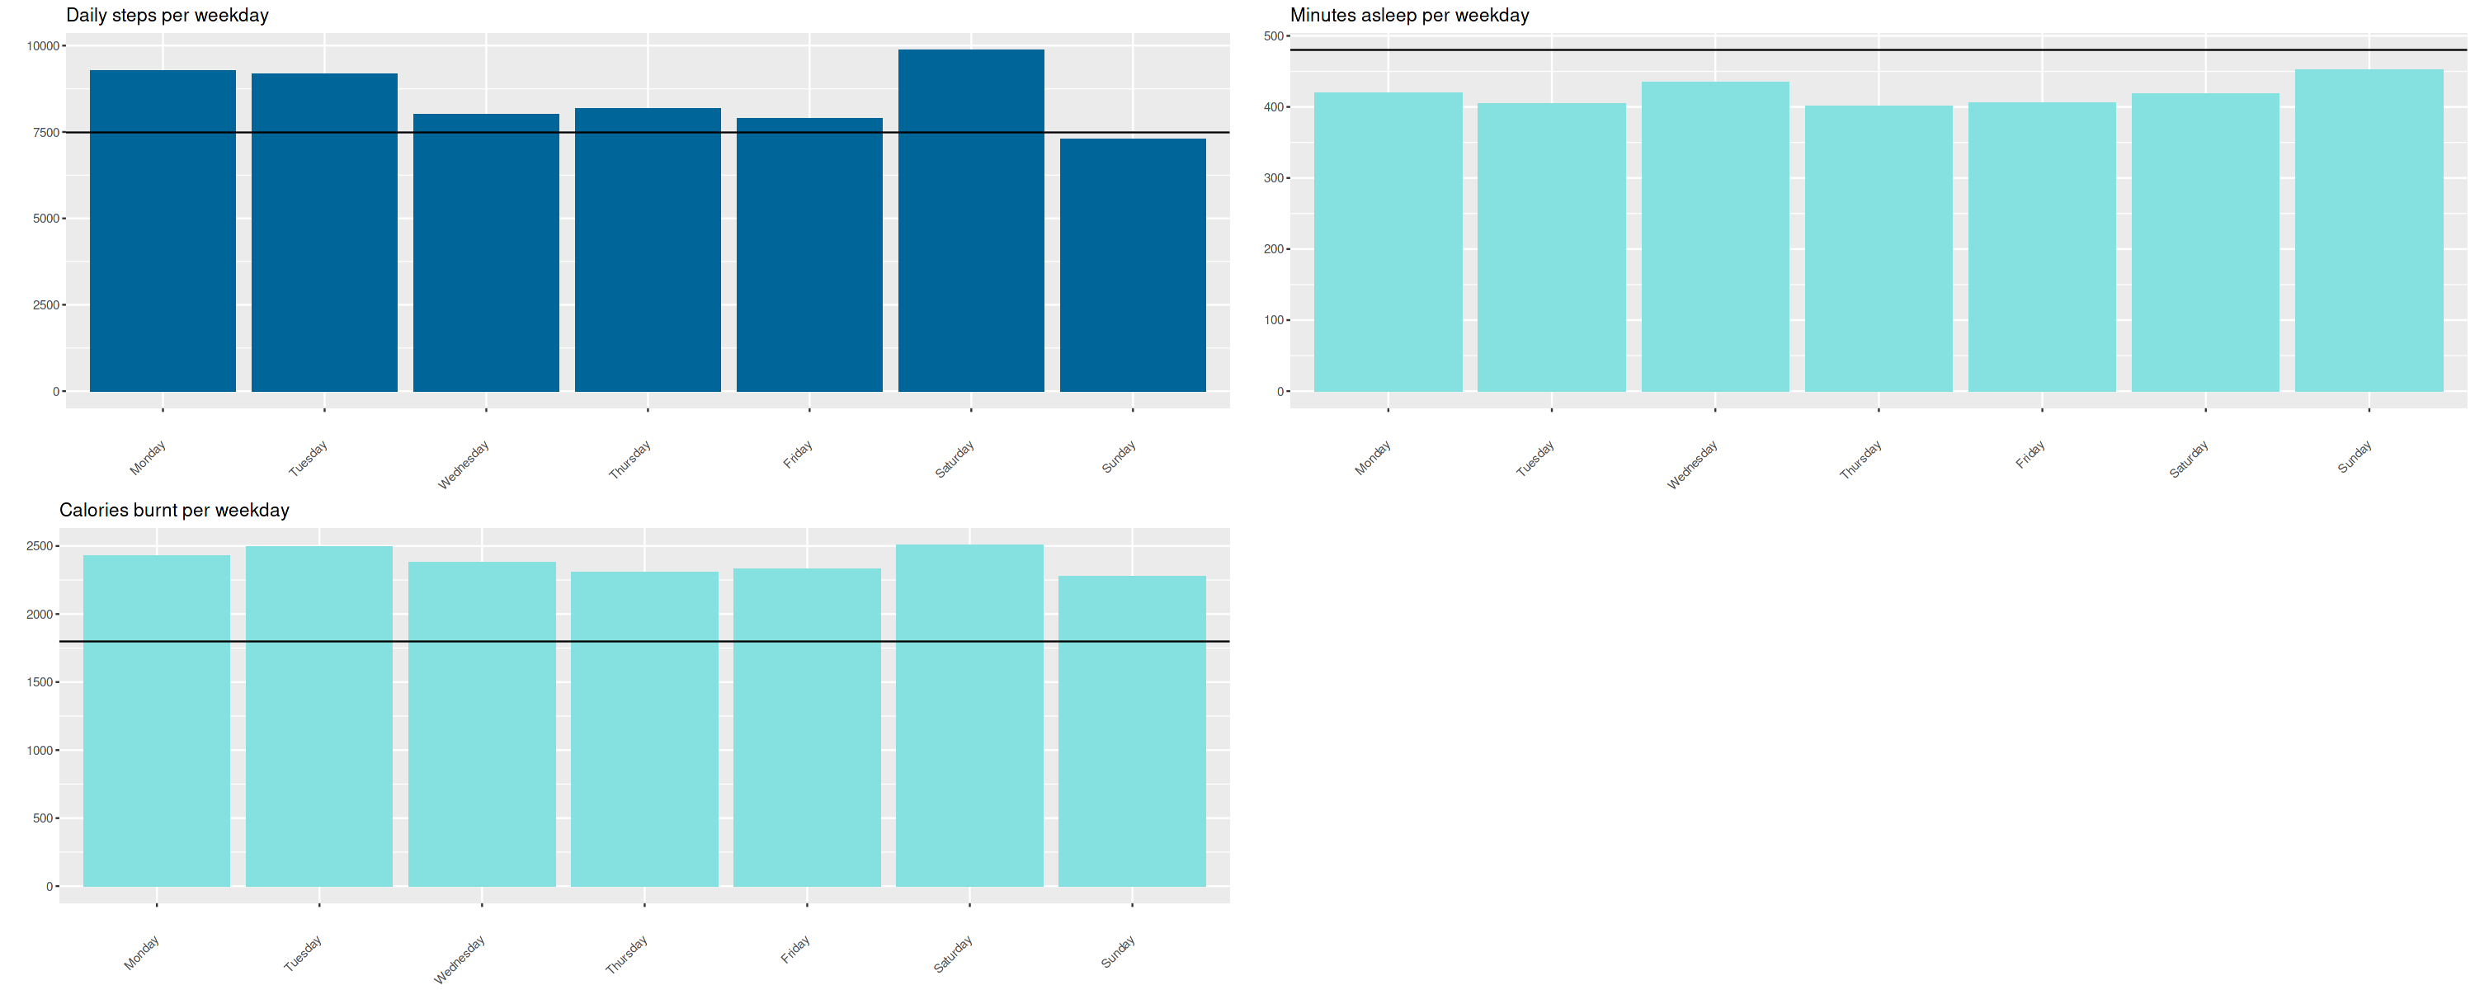
Steps,calories and sleep

Slide 10
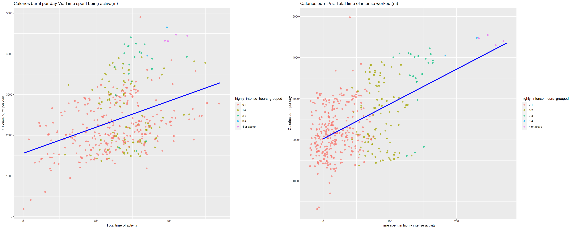
Intensity and caloris

Slide 11
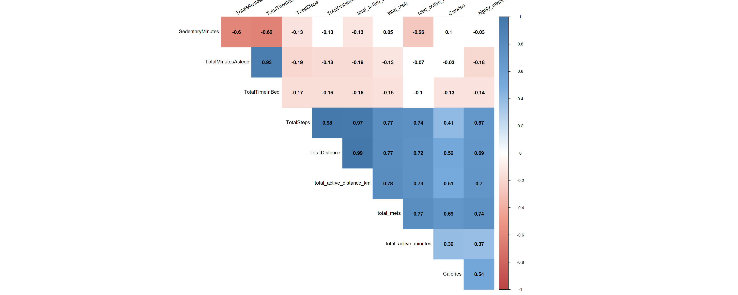
All correlation

Slide 12
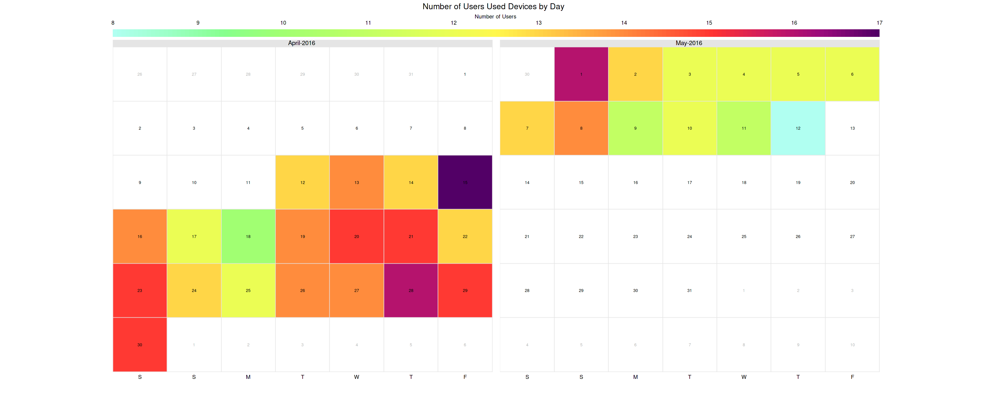
Trend in daily usage

Slide 13
conclusion
Women who work full-time jobs (according to the hourly intensity data) and spend a lot of time at the computer/in a meeting/ focused on work they are doing (according to the sedentary time data)

Slide 14
THANK YOU

